Slide 1

Please Complete The Feedback Form for Intro to QuPath
https://forms.office.com/e/gksNJDTsLd

Slide 2
QuPath Scripting Workshop
James Crichton
12/06/25

Slide 3
Learning Objectives
Not just a coding workshop
Perform real-life analyses
Learn what QuPath is good for (and not so good for)
Practical detail about how to make the most of QuPath
Using Groovy scripting to automate and expand potential analyses

Slide 4
QuPath
Pros | Cons
High throughput 2D analysis (not just big images) | Not >2D imaging (3D or timelapse awkward to work with)
Multiplex images (lots of channels) | Rigid analysis using tools in tabs
Using and training machine learning (traditional approaches also available) | Not so good for non-standard analyses
Visually exploring annotations generated | Generally, cannot manipulate or generate new images
Analysis of big images (pyramid files)
Large and supportive community
Scripting adds significant functionality

Slide 5
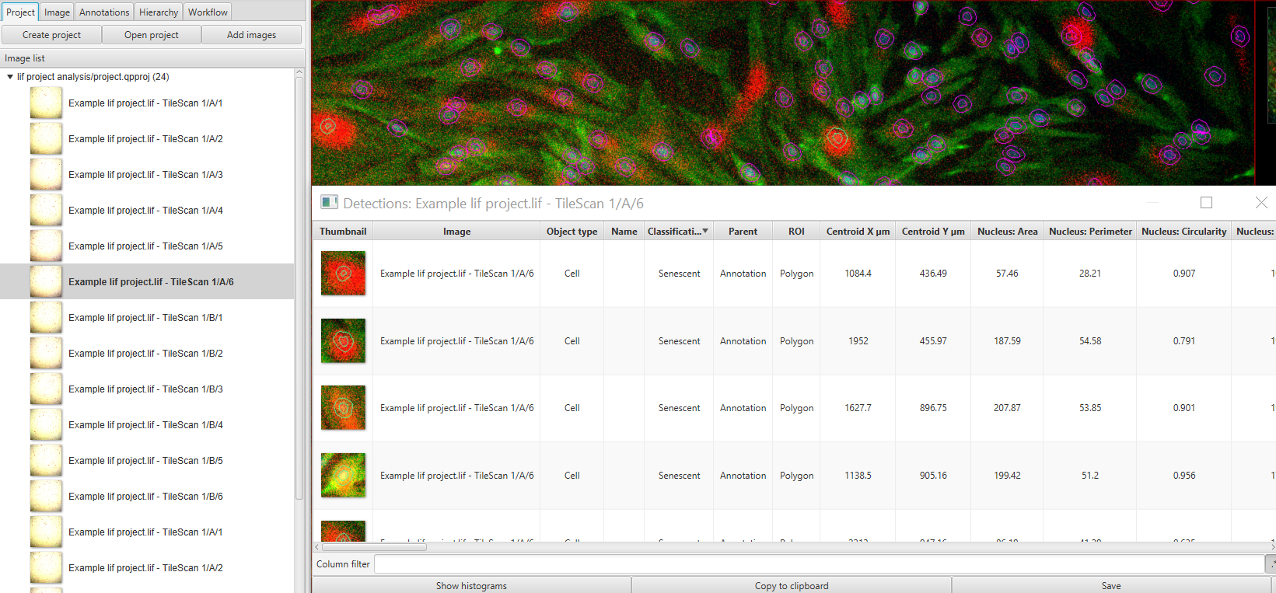
QuPath for quantification in normal-size images, even in awkward image file formats
This was an exercise in the ImageJ Macro workshop
Required a fair bit of code to batch analyse
Practical #1 will do this in QuPath

Slide 6
Practical #1 – Analysing cultured cells

Slide 7
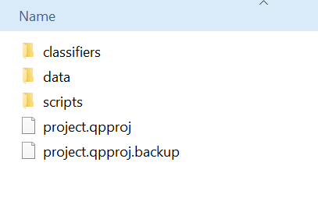
QuPath Projects – You can look at the one we just made
Look inside the “Project” folder
Contains organised sub-folders of related data. E.g.
Scripts
Image data
Image thumbnails
Classifiers
Image locations are recorded and accessed when analysing
Moving locations causes confusion, but QP flags this and lets you rectify it
More folders are added automatically where necessary

Slide 8
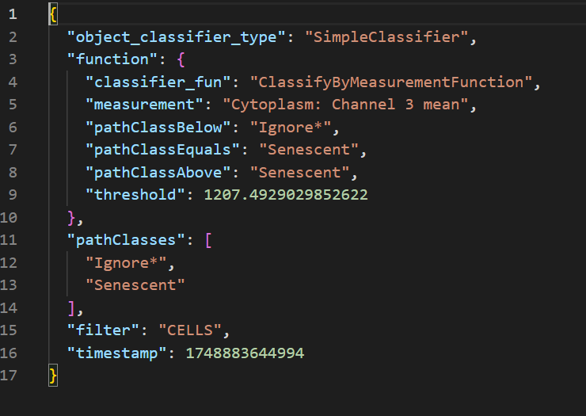
Classifiers Folder – have a look from practical #1
Which classes exist
What classifier models have been saved
e.g. Our cell classifier
These can be opened separately (and are reasonably intelligible!)
This transparency allows them to be copied between projects
You could even monitor them with version control (Git)

Slide 9
Classification
Classification of pixels
To segment regions of an image
Classes are the same as “annotations” e.g. Tissue, Background, or Ignore*
Classification of objects
Objects are things which have already been detected. Typically, cells
Again, classifications are the same as annotations e.g. Neuron, Beta-Cell

Slide 10
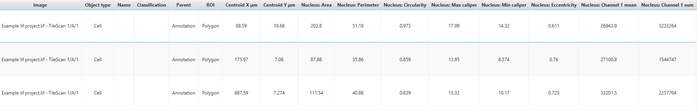
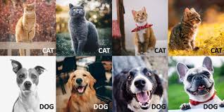
Classification
Generally, both classifications are done either by applying individual thresholds
E.g. Nucleus Area > 60um² = G2 Cell (object classification)
E.g. DAPI >1000 = DNA-positive pixel
Thresholding is fastest option
Or by training a machine learning classifier to combine lots of measurements to classify
E.g. Measurements relating to cell classification
This option might be more accurate
With machine learning, you can choose which data “features” to be included (columns in a table)
The more features you use, the slower it will be. It may also be more accurate…
Is the most important data there (only the data specified will be used)? Do you need more measurements to classify with greater accuracy?
You classify data yourself to train the model
Must include representative diversity

Slide 11
Practical #2 – Object Classification

Slide 12
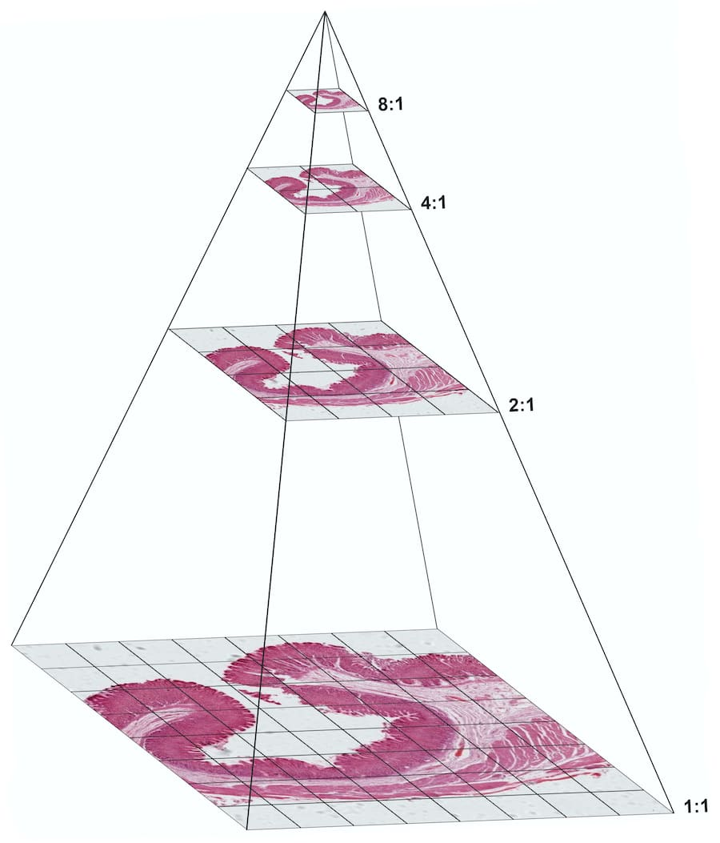

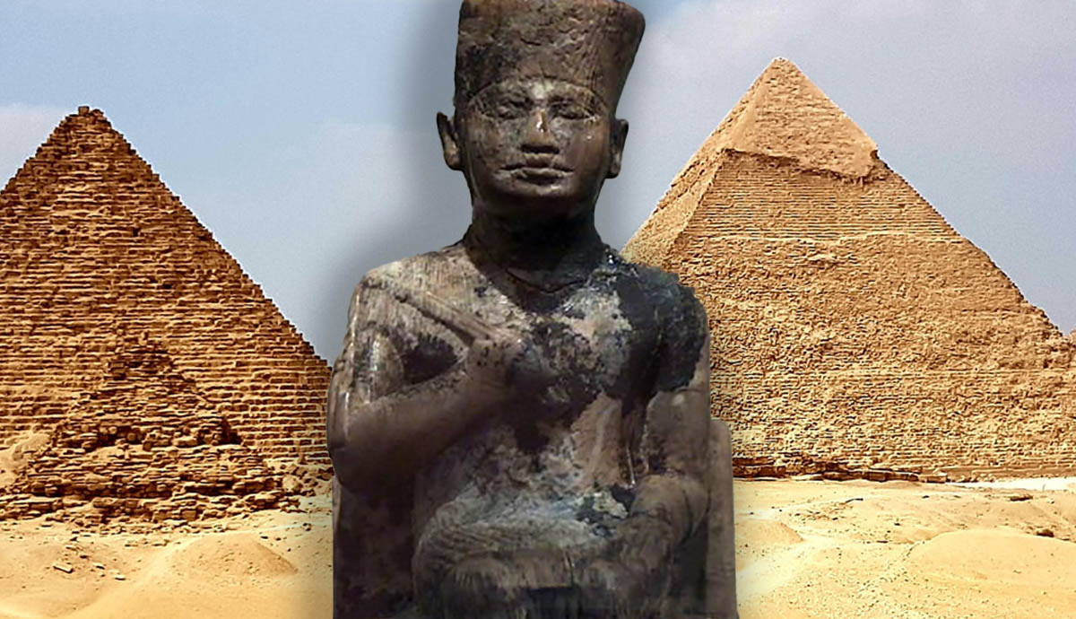
Whole Slide Imaging and Pixel Classification
Whole slide imaging generally requires a pyramidal file format
Not always generated when acquiring large tile-scan images (depends on software)
Pyramids prevent the need to render the whole image at full resolution, but allow selective loading at regions/scales of interest (like Google Earth)
To make file into a pyramid my favourite tool is Kheops (in the BIOP ImageJ plugin)
Can batch process
Works with bioformats (i.e. compatible with diverse input formats)
Kheops built the Great Pyramid of Giza

Slide 13
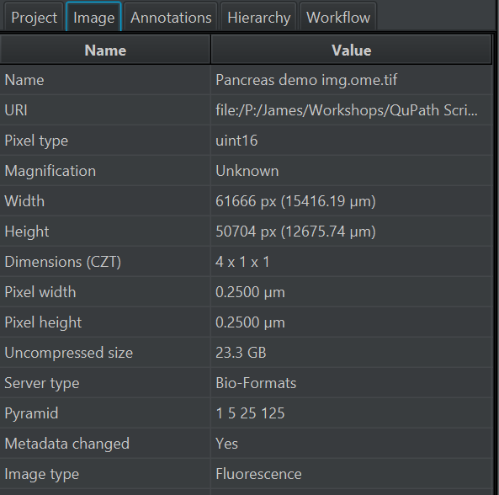
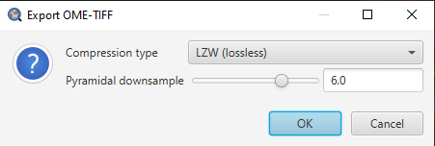
Pyramid files
QuPath has the option to load non-pyramidal files as pyramids, but this is still computationally very demanding and often impossible or prohibitively slow.
See the level of resolutions in the pyramid in the Image tab
Save images in QuPath as pyramids using File >> Export Image >> OME-Tiff

Slide 14
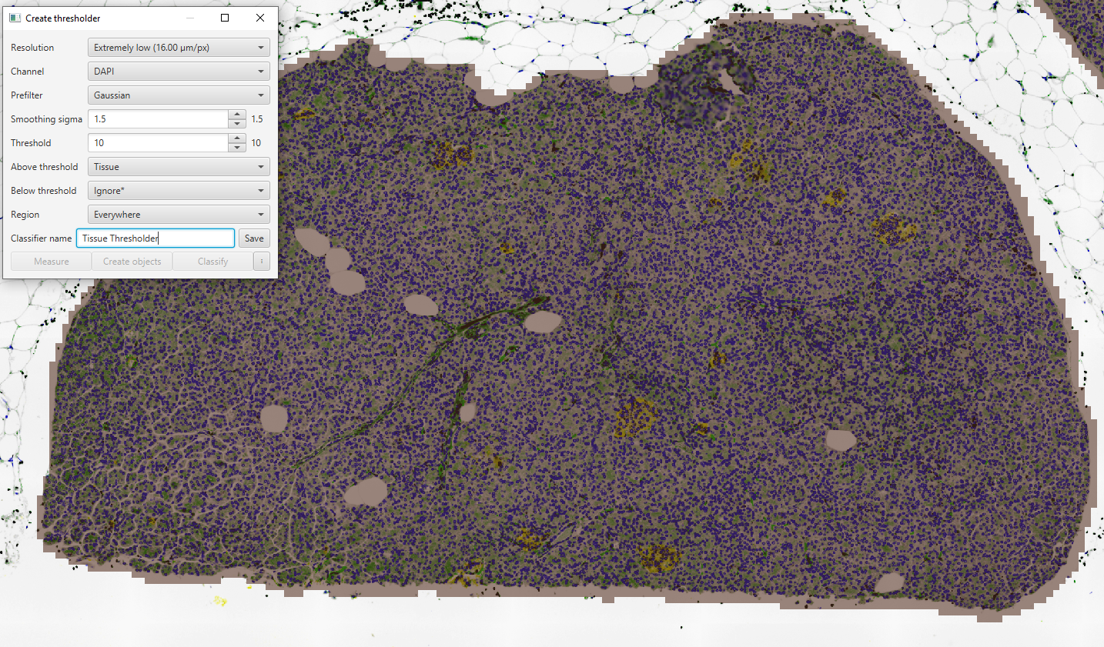
Pixel Classification
Thresholding – one measurement used
The measurement can be a combination of channels (e.g. mean)
Can operate at different resolutions to optimise speed
E.g. low-resolution combination of channels to classify Tissue/Glass

Slide 15
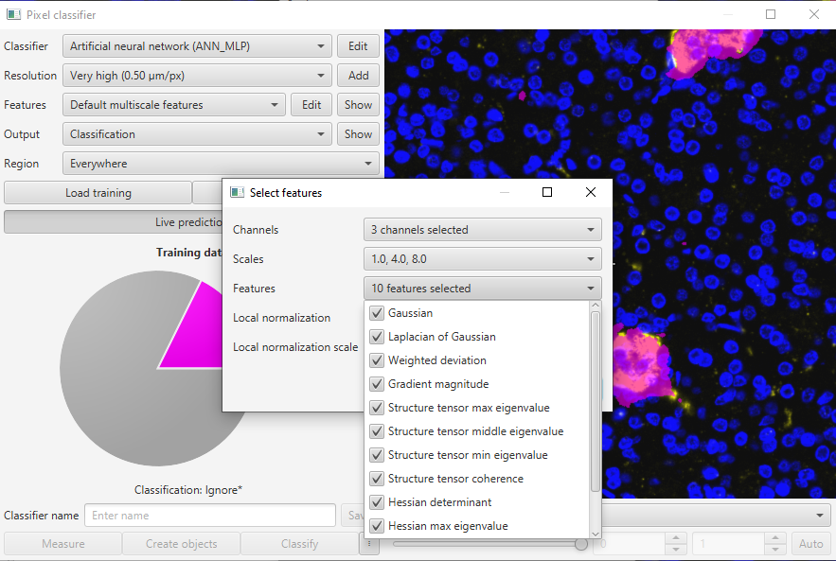
Pixel Classification – Machine Learning
Very similar to object classification… but for pixels
Multiple classes possible (often better to keep simple and classify one thing at a time)
E.g. don’t make a classifier to tissue, islets, and nerves together
Make one for each. Easier to modify and more flexible moving forward.
Again, I find it helpful to think of this as tabular data. Features are:
Fluorescence intensity for each channel
Also, a bunch of other hidden pixel values (“features”) generated by filtering the image
Just Gaussian by default, but can add lots
Look at them with “Show”
x | y | DAPI | Insulin | NeuN | AF | …more?
1 | 1 | 20 | 0 | 2 | 20
2 | 1 | 22 | 3 | 0 | 15
Table of data for each pixel used in ML classification

Slide 16
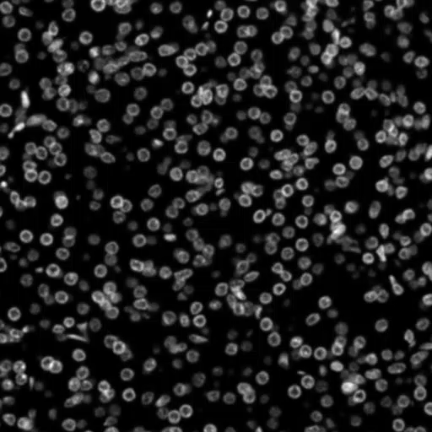
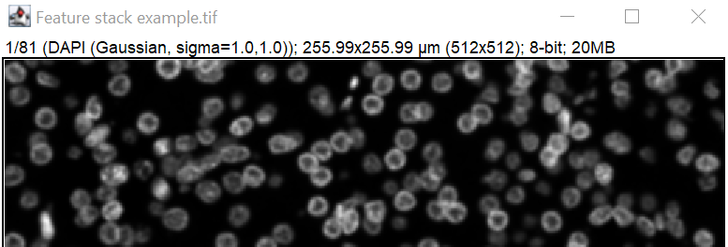
Example stack of image features available
This example uses 81 extra images
Open in ImageJ to see the channel/filter information (in workshop material – “Feature stack example.tif”)

Slide 17
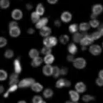
Pixel feature selection
All this extra data adds information about the context of those pixels e.g. near an edge? In a big structure?
Here we’re adding 81 extra columns of data for every pixel being analysed
Think about how different parts of the image change with different filters. Include them where necessary to assist classification.
x | y | DAPI | DAPI Gaussian | DAPI Weighted Deviation | Etc…
1 | 1 | 20
2 | 1 | 22

Slide 18
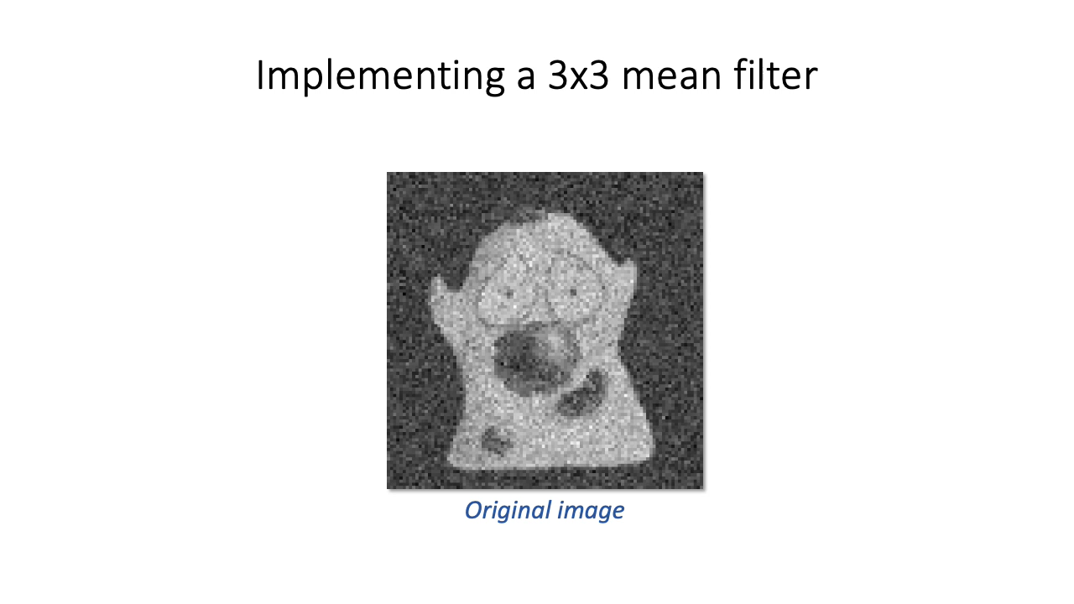
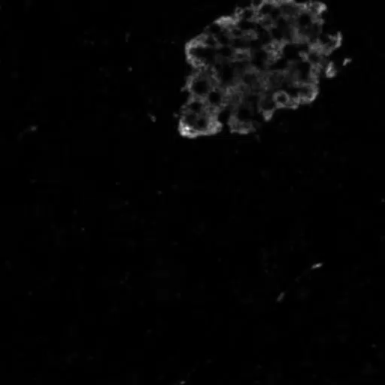
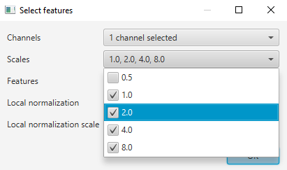
Feature Scale
Features are calculated by doing some maths on each pixel using information from the surrounding pixels.
These surrounding pixels are typically chosen using a “kernel”. Its size will affect the result.
The bigger the scale the bigger the image component being detected e.g. sub-cellular, cellular, multicellular.
Change this to get the data you need to inform your classifier
Gaussian filtering at 4 scales (1,2,4,8)
More on filtering: https://bioimagebook.github.io/chapters/2-processing/4-filters/filters.html

Slide 19
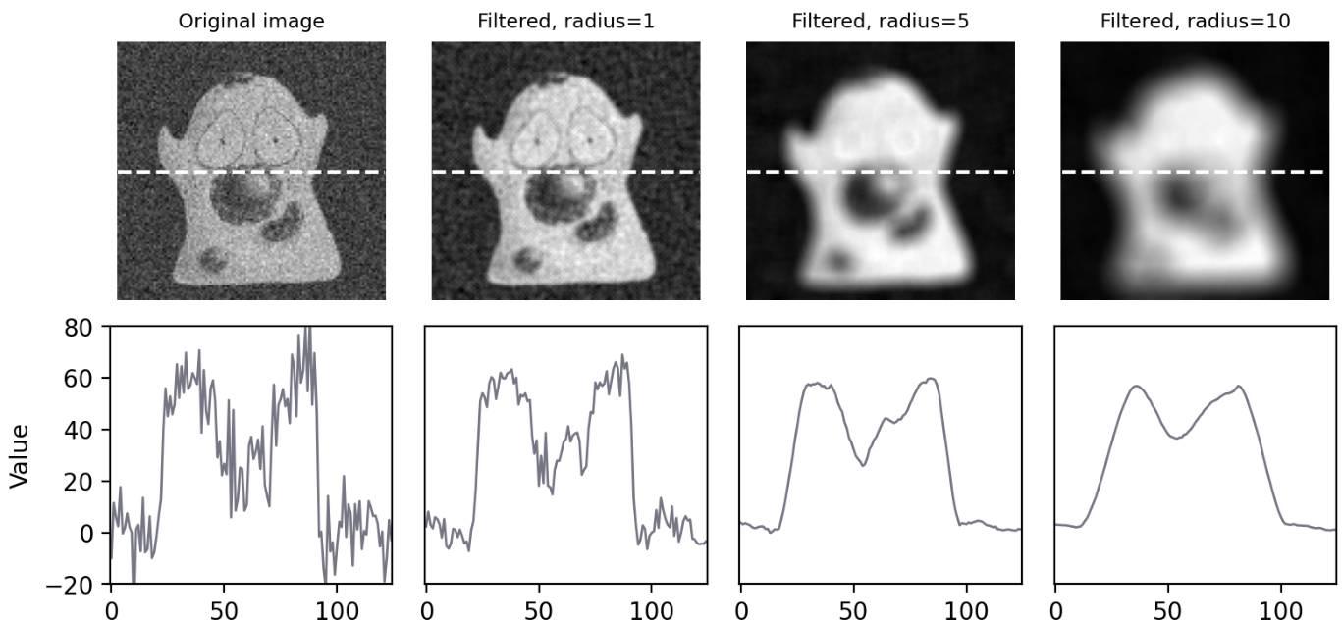
Filter Scale
Gaussian example
Values informative in combination
E.g.
Peaks in 1 finding small bright structures (e.g. cells?)
Peaks in 10 finding big structures e.g. tissue substructure

Slide 20
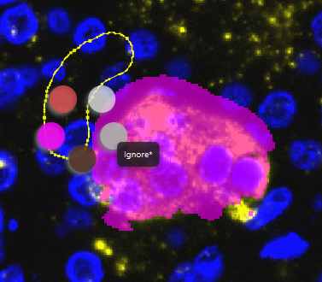
Training a Pixel Classifier
As with an object classifier, representative diversity must be included
Think about your features and what this might mean
Not just loads of pixels from bits of your structure which look the same
Balanced representation is important
Structure edges often especially important and underrepresented.
When training, Shift + right click can be used to quickly classify annotations.
The shape of your annotations is not used to train the model, this is just a way of selecting pixels

Slide 21
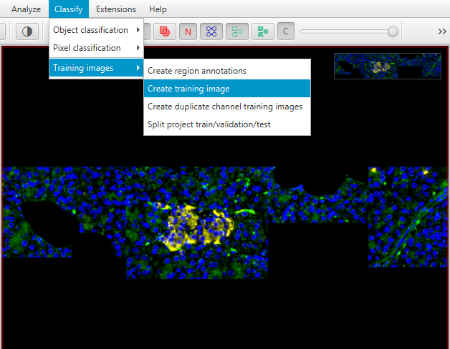
Model training tools/strategies
1. Can make a “training image” which is a collage of selected regions from your dataset
Include diverse examples in a single place
2. Create separate projects for training each model, then combine in another project for analysis
Keeps things very organised and flexible

Slide 22
Practical #3 – Using classifiers from other projects

Slide 23
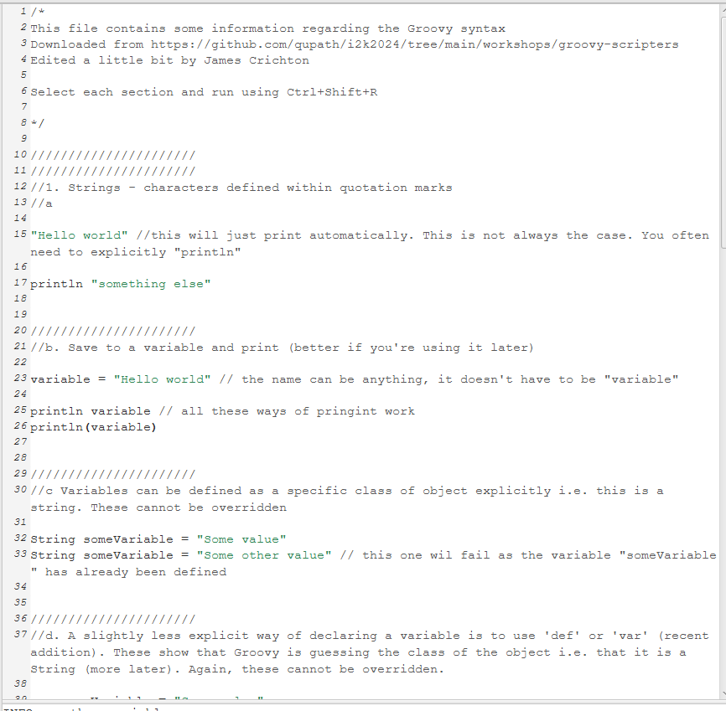
Practical #4 – Starting to script in Groovy 😎
Let’s dive straight into some basic examples to see how the language works
“Practical 4 – Basic Groovy syntax” is a Groovy script, drag and drop this file into QuPath to open
To run each separate section of the script, highlight it and press Ctrl+Shift+R

Slide 24
Object orientated programming
Annotation Object
Groovy is an “Object orientated” programming language
This means that the objects contain both
Data
And methods
This is super-robust but may be a shift in mind-set if you’re used to R (for example)
You need to be careful about having the correct object for a desired task
Can move between object types to do what you want
ROI
Area
Geometry

Slide 25
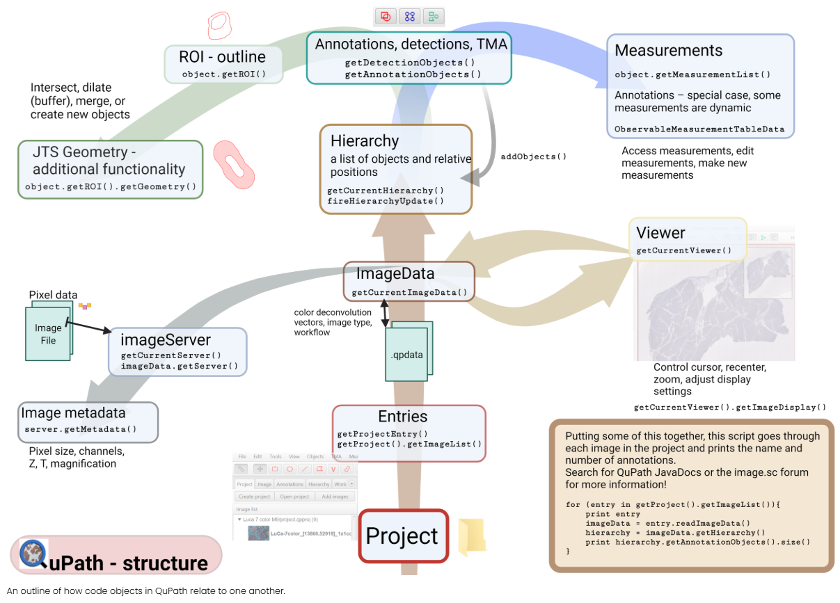
https://www.imagescientist.com/useful-simple-commands

Slide 26
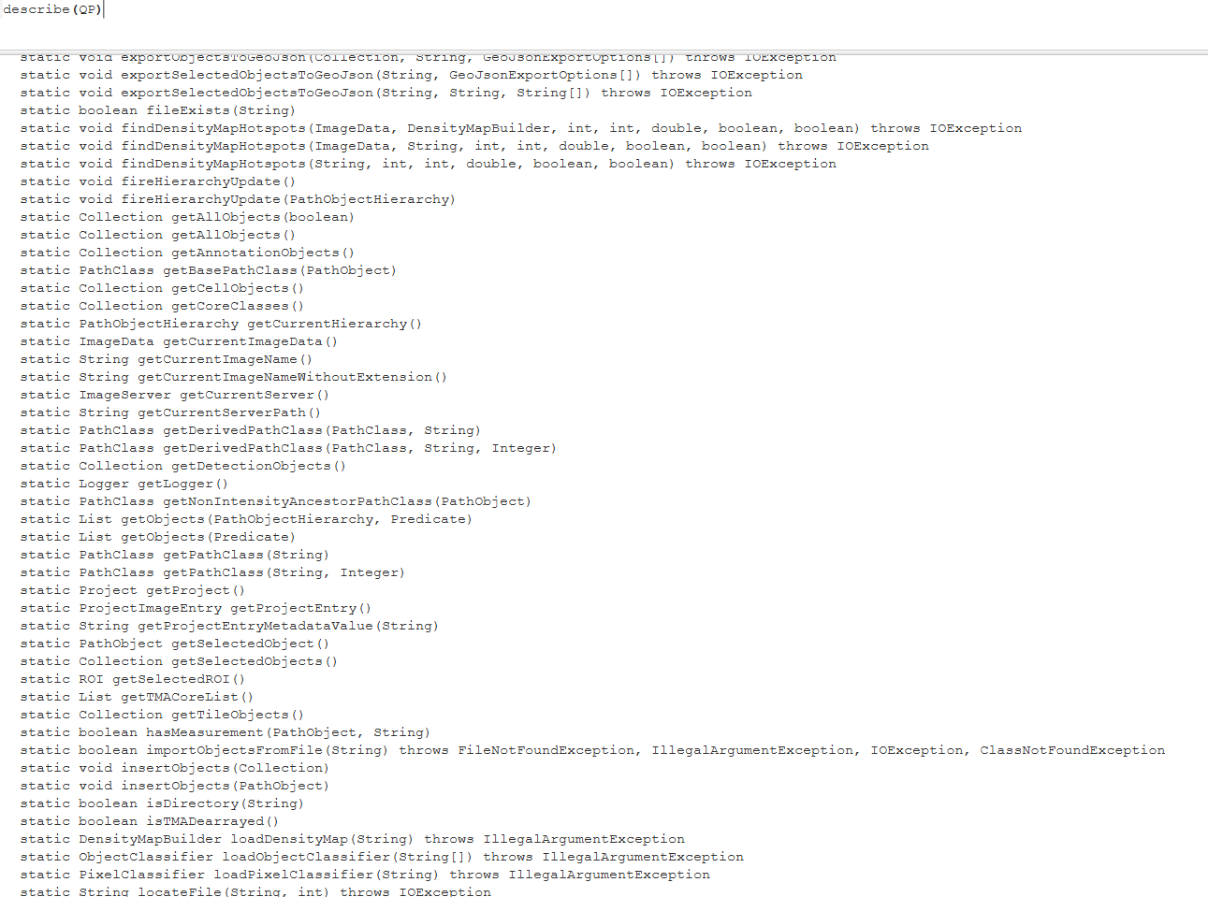
Navigating Groovy
This one command transformed my use of QuPath:
describe()
I use it on everything
Installed Groovy libraries e.g. QP (base). Lots more also available or can be imported
See all the commands possible and associated input/output
Output
Input Arguments
Command

Slide 27
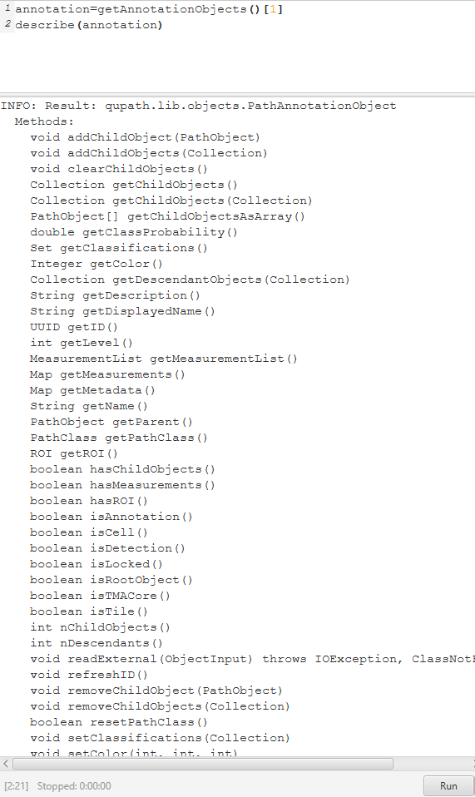
Navigating Groovy
describe()
can also be used on extracted objects e.g. an annotation.
Run command on this object by connecting them with a full stop “.”
e.g.
annotation.getDisplayedName()

Slide 28
Useful resources
Image Scientist
Samples to knowledge workshop 2025:
https://saramcardle.github.io/FS2K/README.html
Ideas 2 Knowledge conference 2024:
https://github.com/qupath/i2k2024
ImageJ, Groovy and Python support materials
Relevant videos from this conference here
QuPath API
For detailed exploration or your options. Actually, very useful
Image.sc focum
https://forum.image.sc/tag/qupath

Slide 29
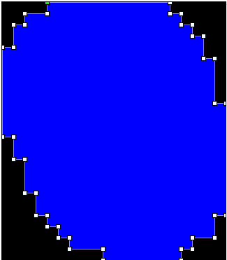
Geometries
Annotation/ROI just has the coordinates at corners
Mask has a value for every pixel
Unlike ImageJ, QuPath doesn’t keep processed images and uses shape descriptions to store spatial data wherever possible
I.e. description of a polygon’s coordinates, rather than a binary mask image showing its shape
This is extremely efficient but does require a different approach and has some limitations
Built commands to compare e.g.
intersection
distance
union (join)
buffer (dilate)

Slide 30
Hierarchies – what’s inside what?
Non-child annotation
Parent
Child annotation
Parent-child relationships
Can be automatically calculated
Ctrl + Shift + R
Objects >> Annotations >> Resolve Hierarchy
Also, options to do this more selectively
“Annotations” must be completely contained to be a child
“Detections” need an overlapping centroid
Child Detection
Child Detection
Non-child Detection

Slide 31
Hierarchies
Outer Ring Object
An example where you might want to force a hierarchy is if you create a ring around an object
A parent/child relationship will not automatically be detected as one is not actually contained in the other
Inner object

Slide 32
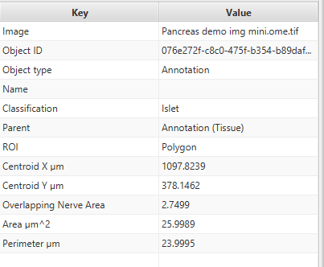
Naming in hierarchies
The object “Name” and “Classification” is used in the “Parent” data
Annotations don’t automatically have a Name. This is often empty
Annotations have a unique “ObjectID”
If you want, you can make the ObjectID into the Name, so you can work out exactly which object is the parent
Be tactical with your use of the “Name” value. You can add measurements, but just numeric. This is the only place you can add a string of characters.

Slide 33
Practical #5
Practical 5 scripts guide you through a range of common processes.
Start by opening the QuPath Project in “Practical 5/Analysis Project”
Open the image (Project >> Double click image to open)
May need to be connected to the correct image file location. Dialogue to do this
Open scripts from within the project: Automate >> Project Scripts
Looping over islets
Islet Nerve Overlap
Hierarchy script
Manipulating annotations and editing the hierarchy

Slide 34
Extras

Slide 35
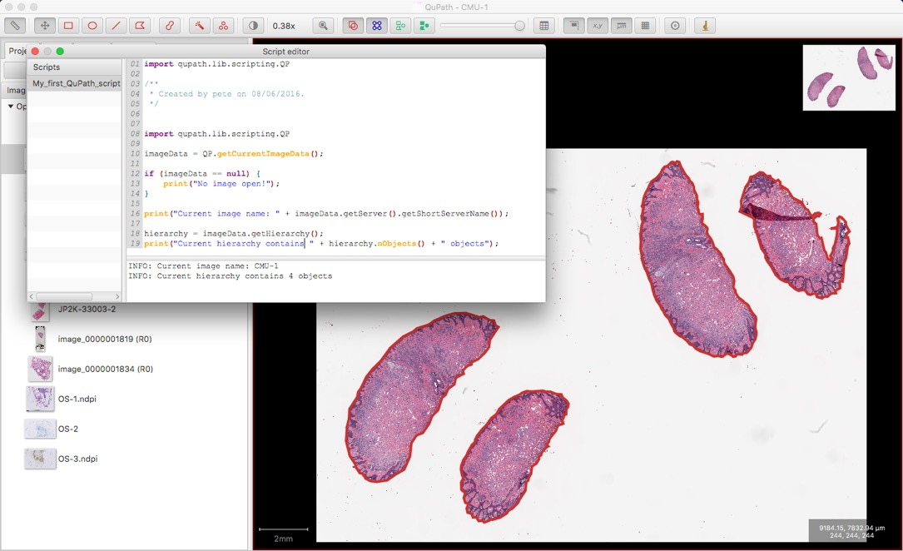
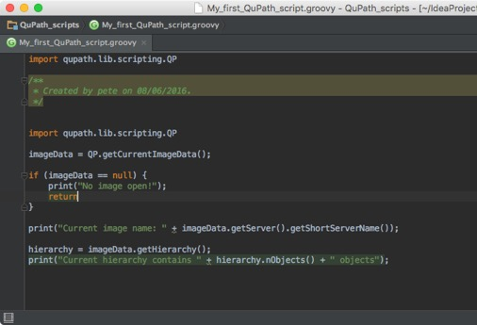
IntelliJ IDE
https://github.com/qupath/qupath/wiki/Advanced-scripting-with-IntelliJ
Connect IntelliJ to QuPath and get autofill and hints etc

Slide 36
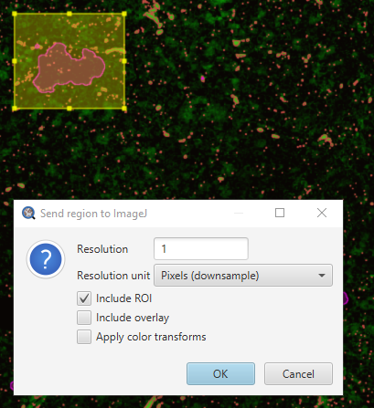
ImageJ
ImageJ is built into QuPath
Export to it
Use for making figures
Will need to downsample if a big area – not exported as a pyramid.
Also use for generating new ROIs and using the wider functionality of ImageJ
Can direct to your own installation with plugins e.g. Fiji

Slide 37
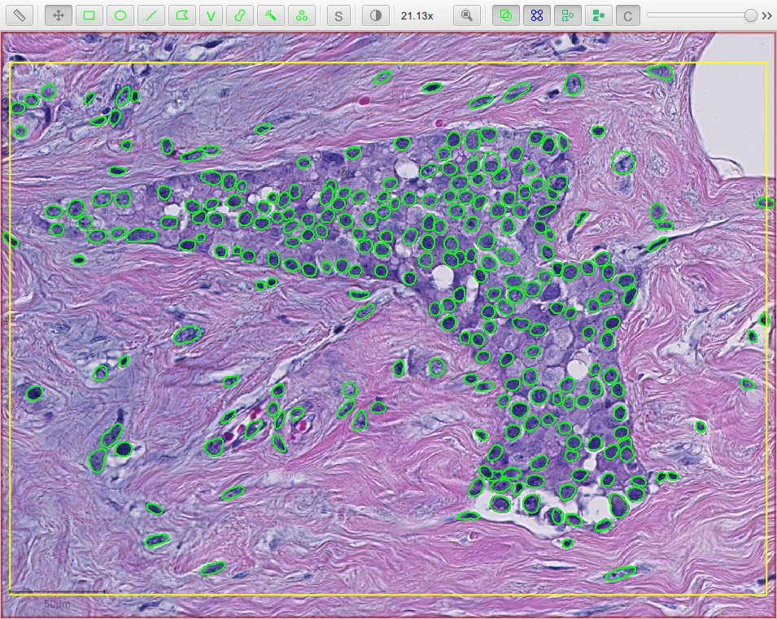
Stardist
Pre-trained deep learning for nuclei segmentation
Fluorescence and brightfield
Follow the installation guide here:
https://github.com/qupath/qupath-extension-stardist
Need to download models from here and direct to them in the stardist script:
https://github.com/qupath/models/tree/main/stardist

Slide 38
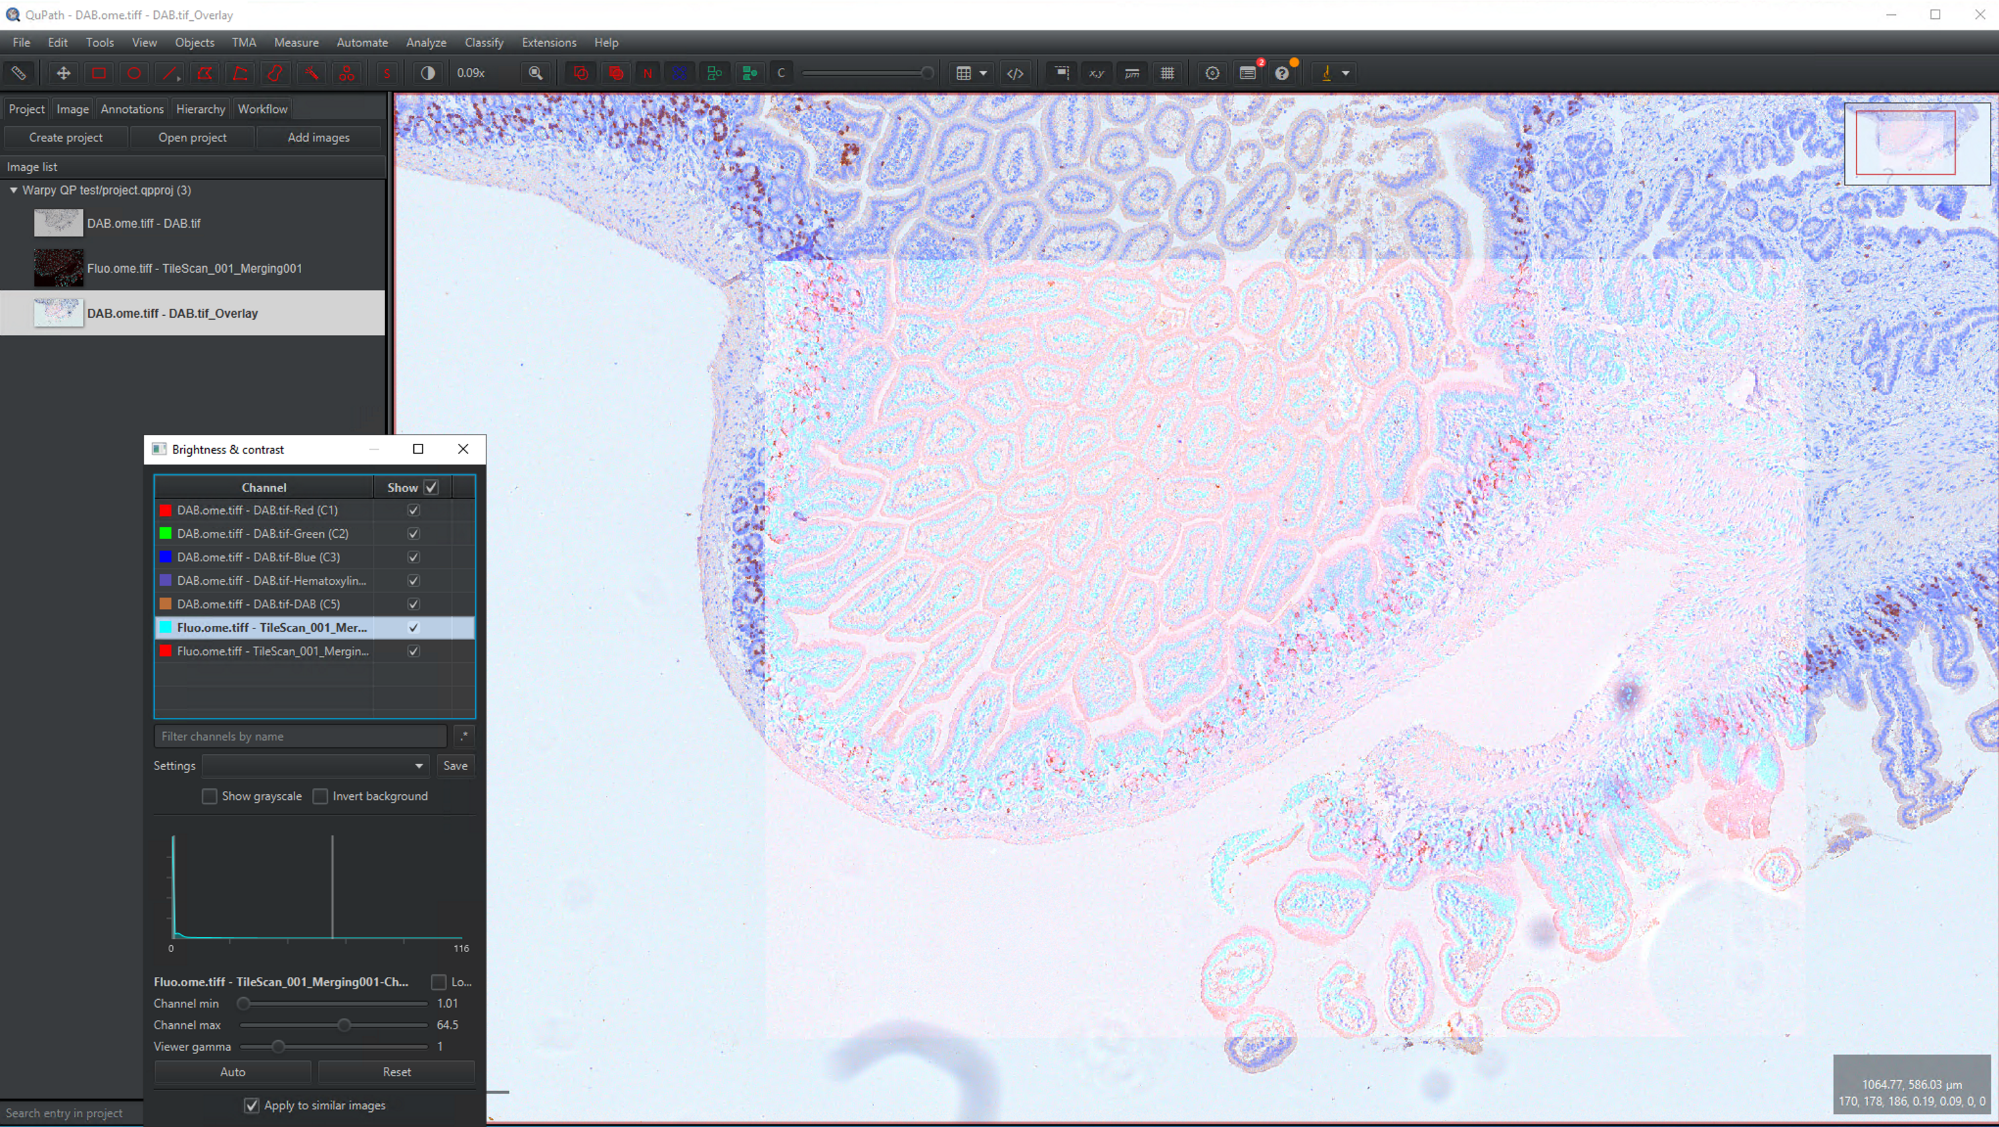
Warpy
Image registration/combination
E.g. for re-imaging tissue or imaging serial sections
https://imagej.net/plugins/bdv/warpy/warpy
Look at the videos for a quick taster

Slide 39
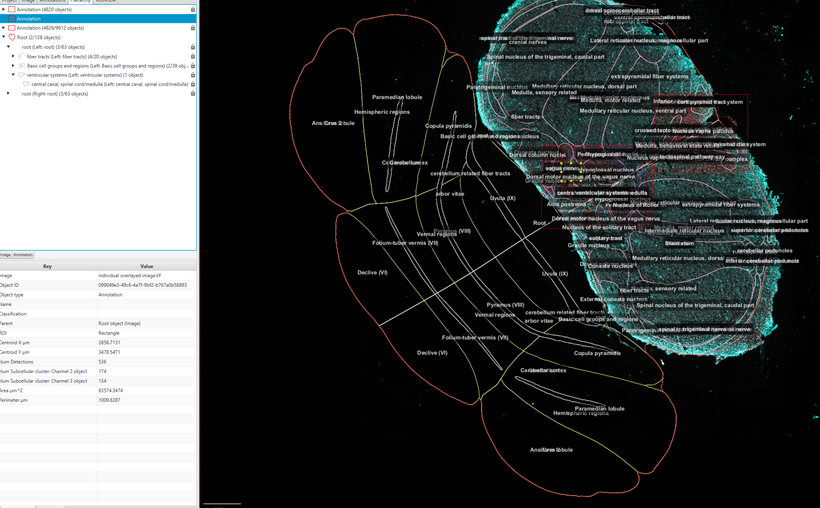
(Also, further extension for Aligning Big Brains and Atlases – ABBA)
https://abba-documentation.readthedocs.io/en/latest/installation/installation.html
Included with Warpy
Align to brain atlases e.g. Allen Brain Atlas

Slide 40
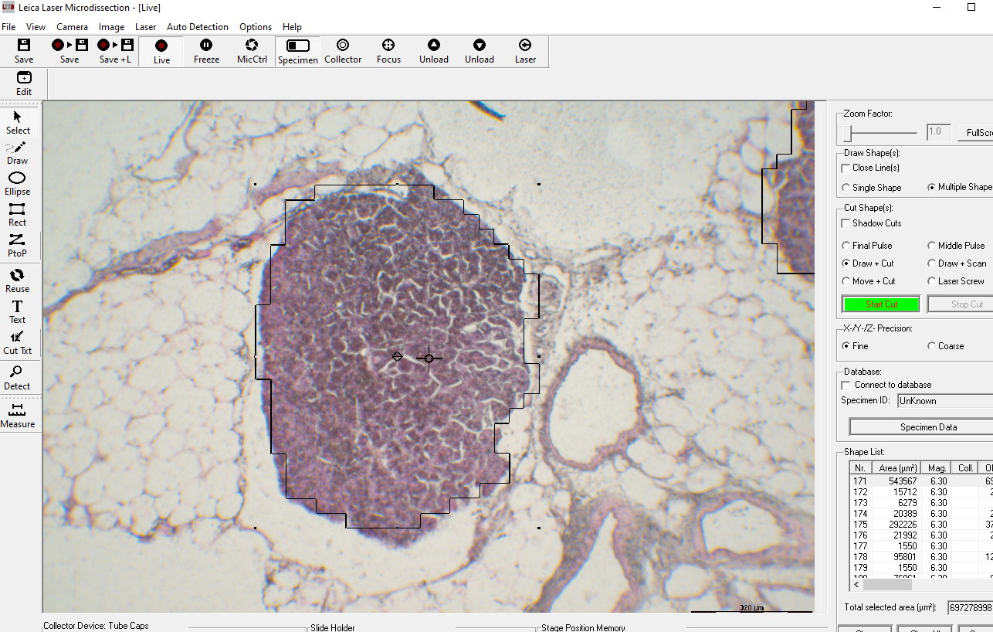
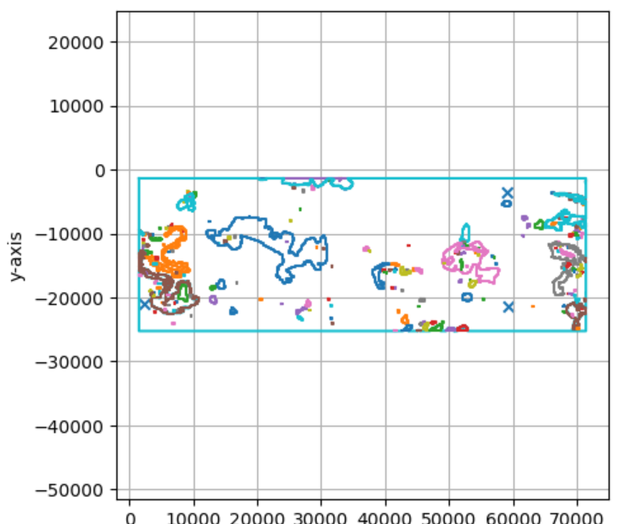
Use annotations for laser capture at RILD

Slide 41
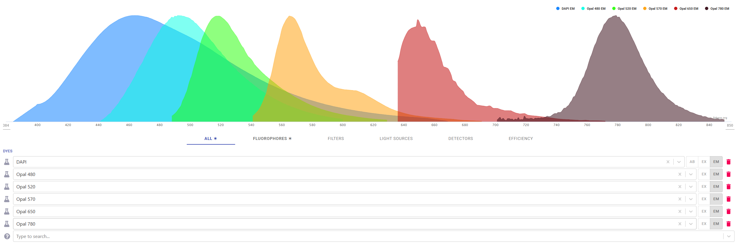
Colour unmixing
Work in progress at RILD
Spectrally unmix stains to calculate separate channels
We do this for fluorescent stains. We are working on colour stains
i.e. not just Red, Green, Blue filter, but application of a tuneable range of wavelength filters

Slide 42
Please Complete The Feedback Form
https://forms.office.com/e/gksNJDTsLd

